Slide 1
BBM-382 – SOFTWARE ENGINEERING
SPRING 2018
Lecture 7
Dr. Ayça TARHAN

Slide 2
Chapter 7 – Design and Implementation

Slide 3
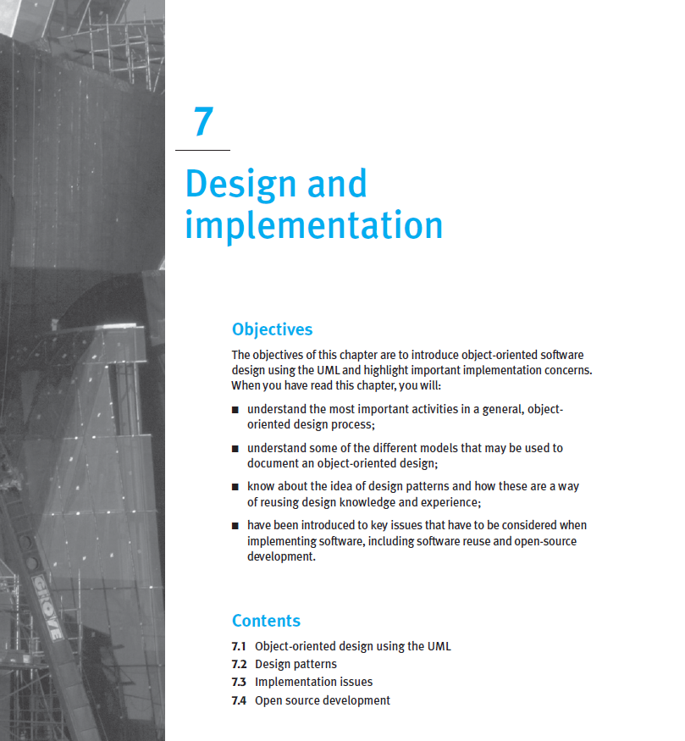
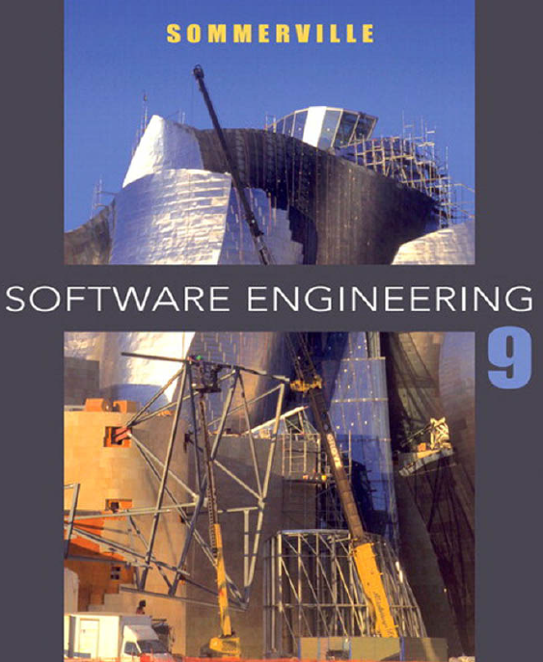
From the book
Read it online!

Slide 4
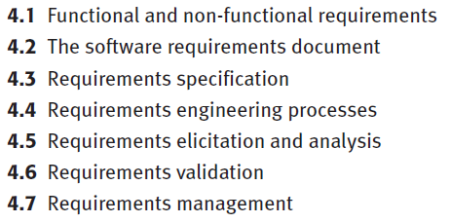
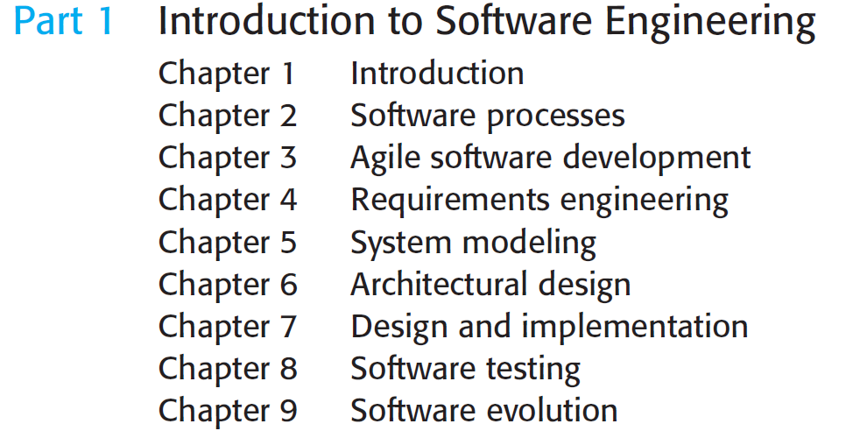
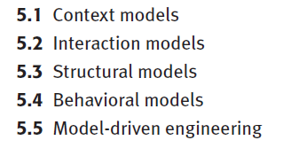
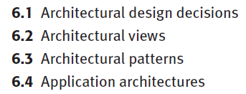
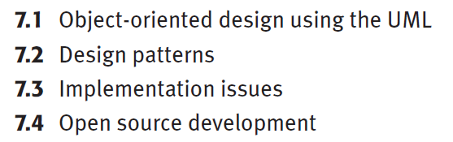
Chapter 7 – Design and Implementation
Use-case diagrams

Slide 5
Chapter 7 – Design and Implementation
Object-oriented design using the UML
Design patterns
Implementation issues
Open-source development

Slide 6
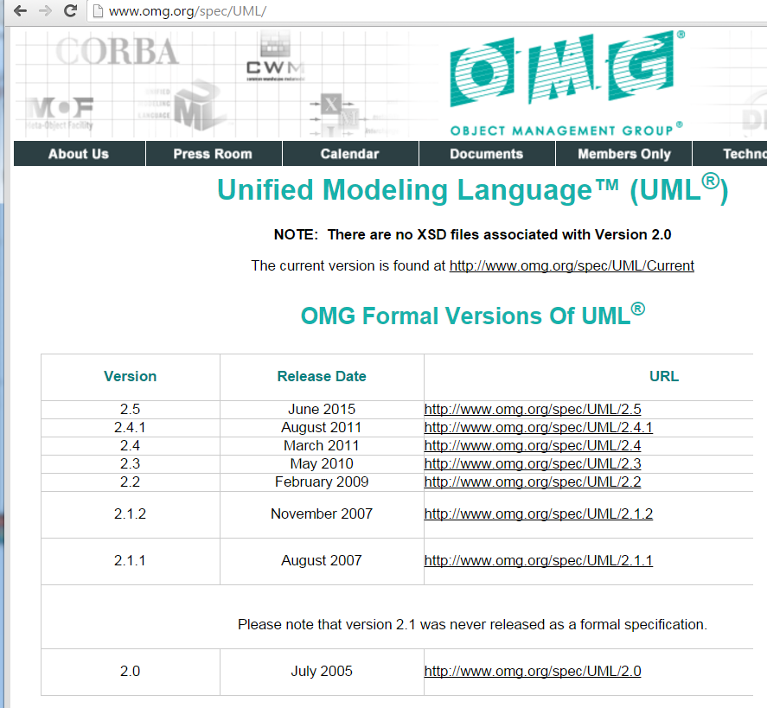
More about UML
Latest version:

Slide 7
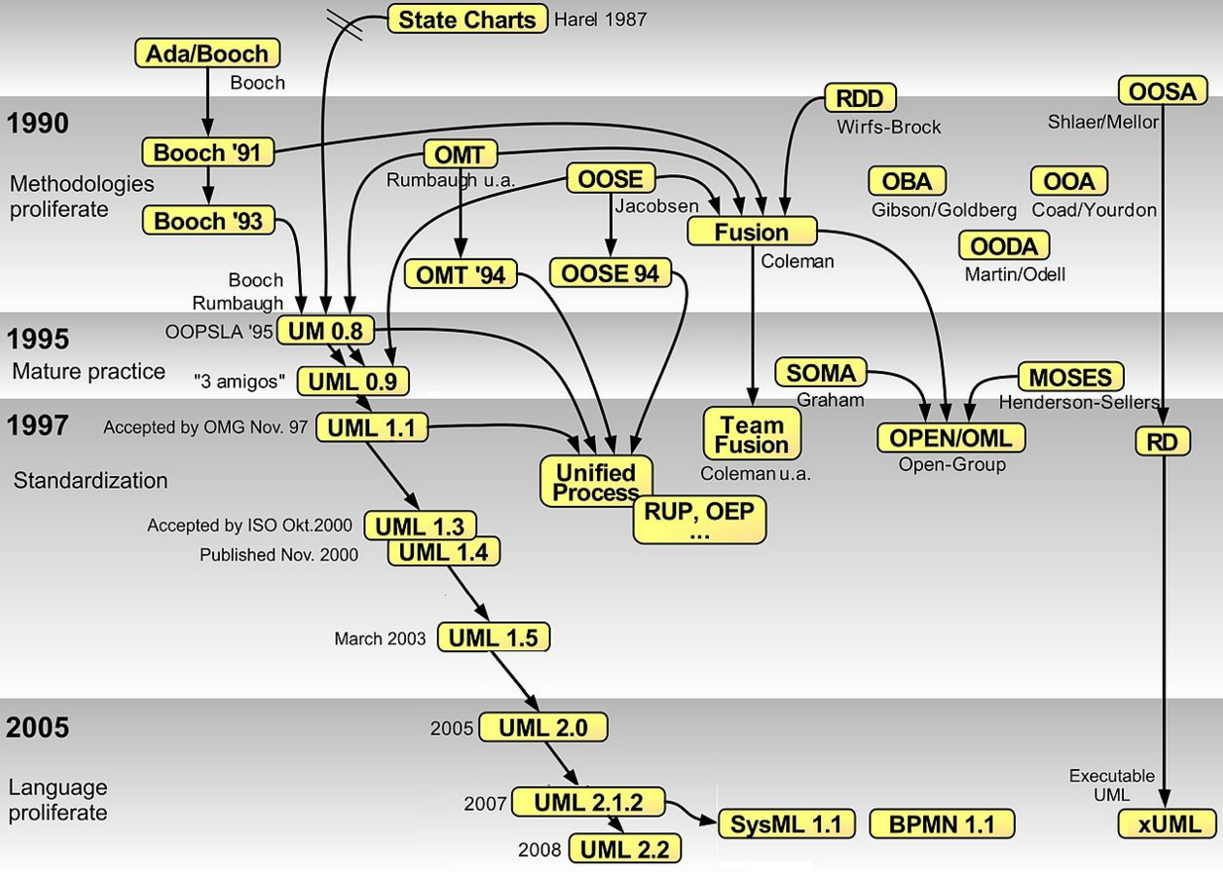
More about UML

Slide 8
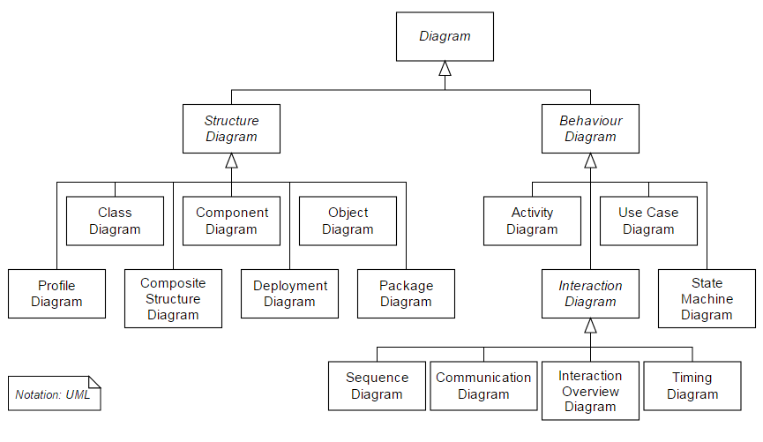
More about UML
14 diagrams in total
Ch. 5
Ch. 5
Ch. 4
Ch. 4, 6
Ch. 6
Ch. 4, 6
Ch. 5
Ch. 4

Slide 9
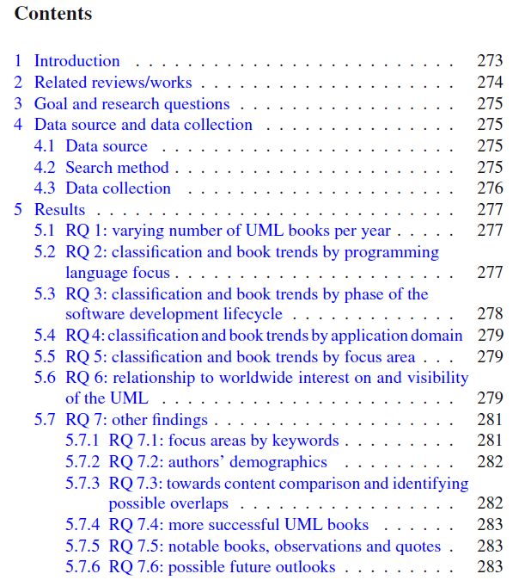
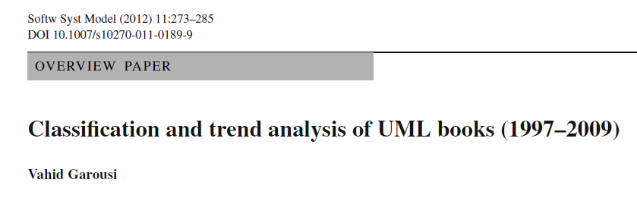
Lots of UML books
208 books on from its inception in 1997 until 2009.

Slide 10
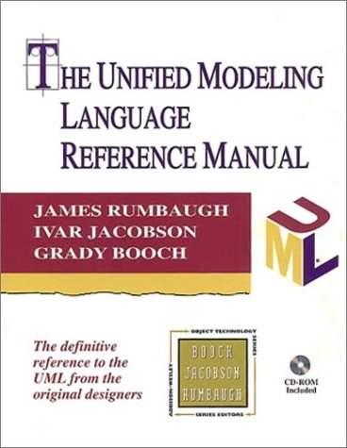
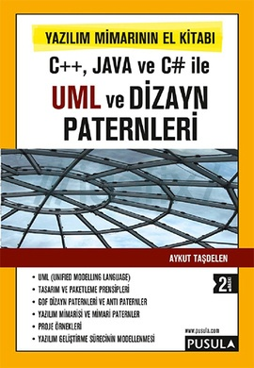

Lots of UML books: a few of them

Slide 11
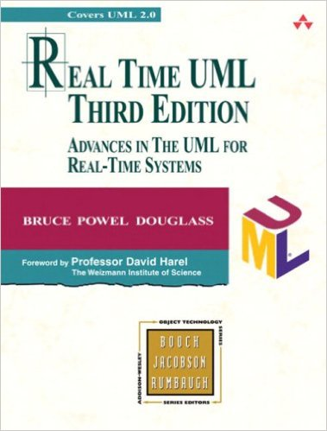

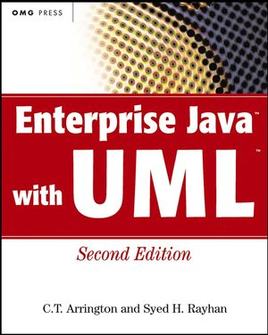
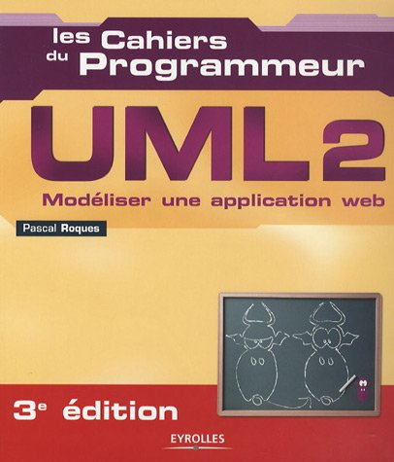
Lots of UML books: a few of them

Slide 12
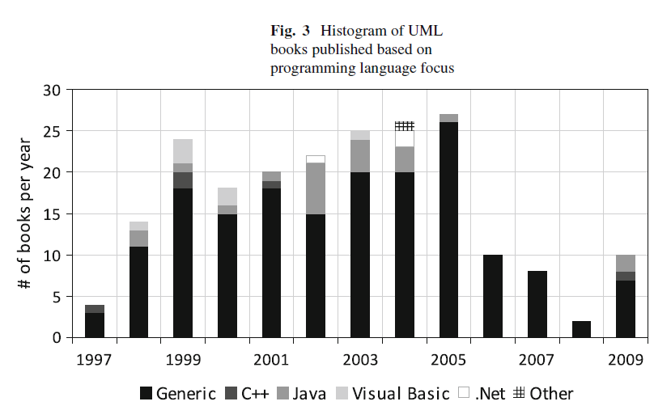
Lots of UML books: by programming language

Slide 13
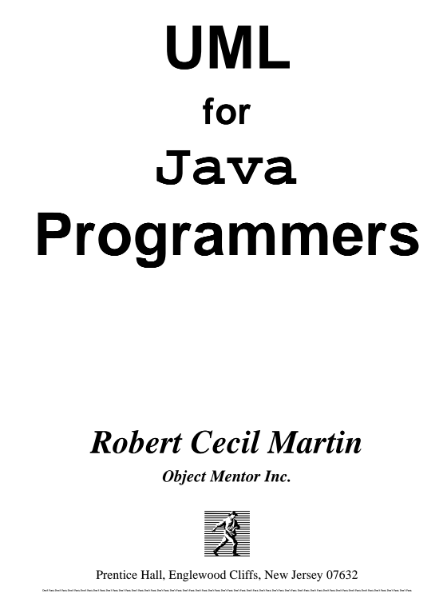
Lots of UML books: by programming language
One book PDF in our website:
UML for Java Programmers
PDF:
https://drive.google.com/file/d/0B6dKdxaNjBENRjRqUDZUby1xMFE/view?usp=sharing

Slide 14
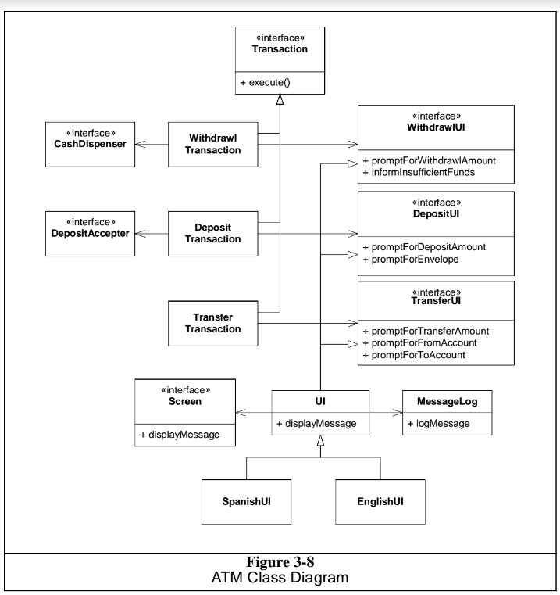
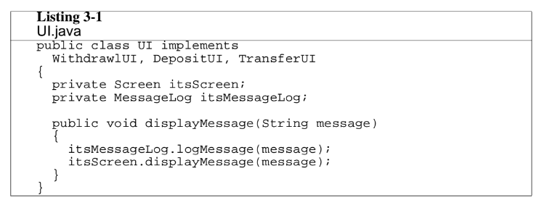
Lots of UML books: by programming language

Slide 15
Chapter 7 – Design and Implementation
Object-oriented design using the UML
Design patterns
Implementation issues
Open-source development

Slide 16
Design patterns
In software engineering, a pattern is a general repeatable solution to a commonly occurring problem in software engineering.
Patterns are a means of representing, sharing and reusing knowledge.
There are different types of pattern in SW engineering:
Architectural patterns
Design patterns
Test patterns
Performance patterns
Process patterns
…

Slide 17
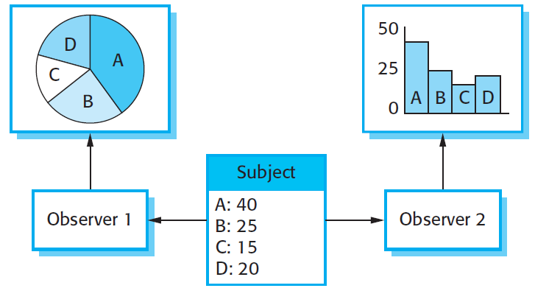
Design patterns: An example Multiple displays using the Observer pattern

Slide 18
The Observer pattern
Name
Observer.
Description
Separates the display of object state from the object itself.
Problem description
Used when multiple displays of state are needed.

Slide 19
Design patterns
A design pattern is a way of reusing abstract knowledge about a problem and its solution.
A pattern is a description of the problem and the essence of its solution.
It should be sufficiently abstract to be reused in different settings.
Pattern descriptions usually make use of object-oriented characteristics such as inheritance and polymorphism.

Slide 20
Pattern elements
Name
A meaningful pattern identifier.
Problem description.
Solution description.
Not a concrete design but a template for a design solution that can be instantiated in different ways.
Consequences
The results and trade-offs of applying the pattern.

Slide 21
REMINDER: Multiple displays using the Observer pattern

Slide 22
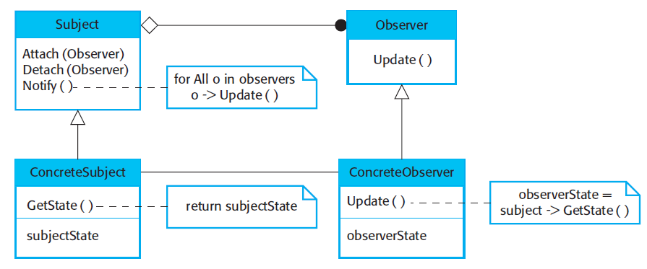
A UML model of the Observer pattern

Slide 23

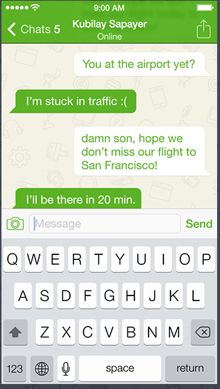
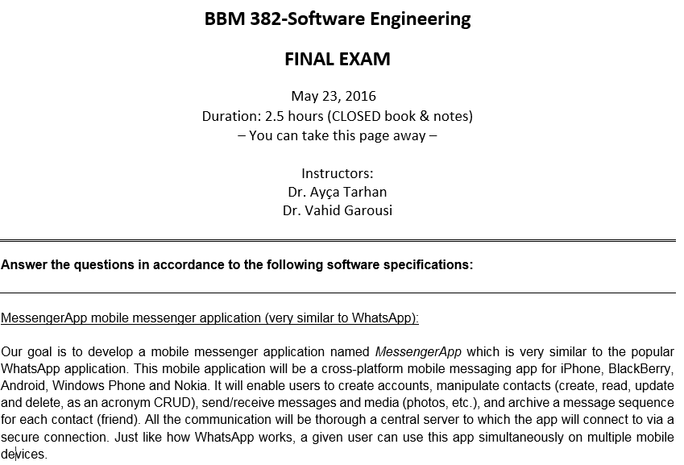
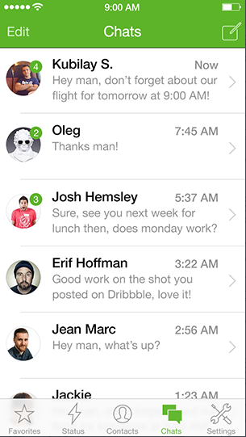
In-class exercise
From 2016 final exam:

Slide 24
In-class exercise
From 2016 final exam:
As the 1st step, draw the class diagram for this system, following the MVC architecture in your class diagram.
To save you time, only put the class names in the class diagram, and NOT the method/attribute names of each class.
As the 2nd step, considering the system class diagram, there is a good opportunity to use the Observer pattern to improve the system design. Identify that opportunity and apply the Observer pattern to improve the class diagram.

Slide 25
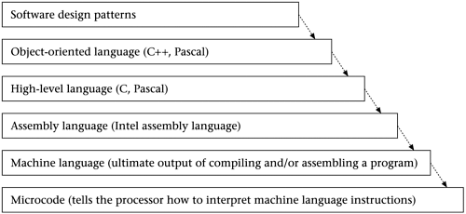
Design patterns
Levels of design

Slide 26
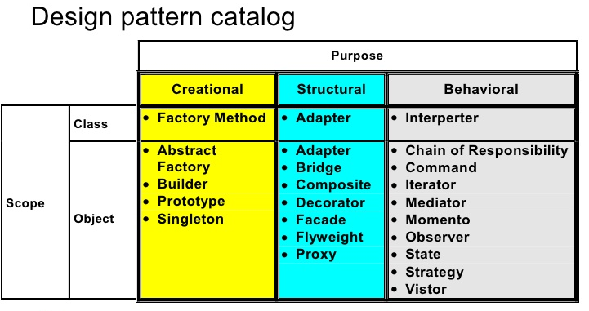
Design patterns: many of them

Slide 27

Design patterns: Gang of Four (GoF)

Slide 28
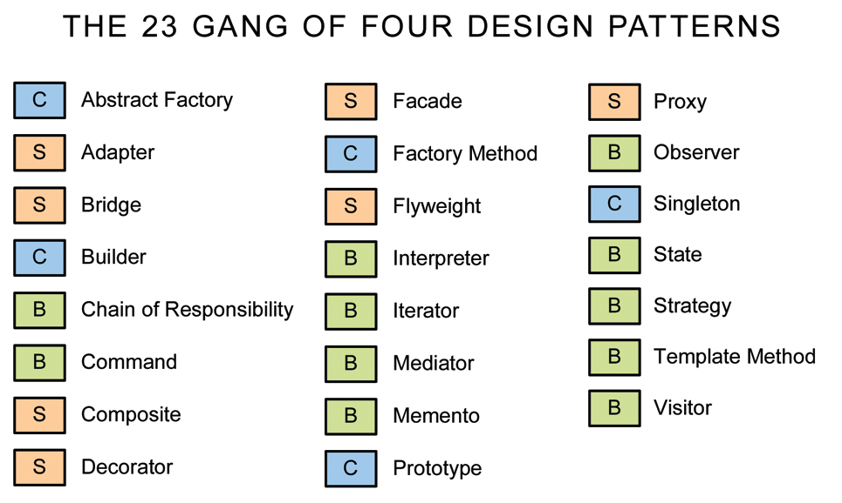
Design patterns: many of them
C: Creational, S: Structural, B: Behavioral

Slide 29
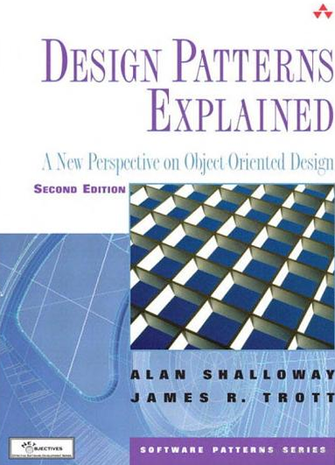

Design patterns: We just spent a few minutes!
There are courses and many books on Design patterns…

Slide 30
Chapter 7 – Design and Implementation
Design patterns
Implementation issues
Open-source development

Slide 31
Implementation issues
Focus here is not on programming, although this is obviously important, but on other implementation issues that are often not covered in programming books (or courses):
Reuse: Most modern software is constructed by reusing existing components or systems. When you are developing software, you should make as much use as possible of existing code.
Configuration management: During the development process, you have to keep track of the many different versions of each software component in a configuration management system.
Host-target development: Production software does not usually execute on the same computer as the software development environment. Rather, you develop it on one computer (the host system) and execute it on a separate computer (the target system).

Slide 32
Implementation issues
Focus here is not on programming, although this is obviously important, but on other implementation issues that are often not covered in programming books (or courses):
Reuse: Most modern software is constructed by reusing existing components or systems. When you are developing software, you should make as much use as possible of existing code.
Configuration management: During the development process, you have to keep track of the many different versions of each software component in a configuration management system.
Host-target development: Production software does not usually execute on the same computer as the software development environment. Rather, you develop it on one computer (the host system) and execute it on a separate computer (the target system).

Slide 33
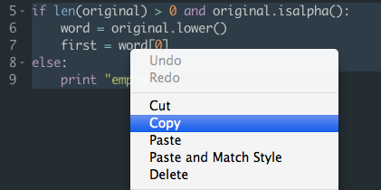
Code Reuse: A bit of history
Ad hoc code reuse has been practiced from the earliest days of programming.
Programmers have always reused sections of code, functions, and procedures.
Software reuse as a recognized area of study in software engineering, however, dates only from 1968 when Douglas McIlroy of Bell Laboratories proposed basing the software industry on reusable components.

Slide 34
Reuse
From the 1960s to the 1990s, most new software was developed from scratch, by writing all code in a high-level programming language.
The only significant reuse of software was the reuse of functions and objects in programming language libraries.
Costs and schedule pressure mean that this approach became increasingly unviable, especially for commercial and Internet-based systems.
An approach to development based around the reuse of existing software emerged and is now generally used for business and scientific software.

Slide 35
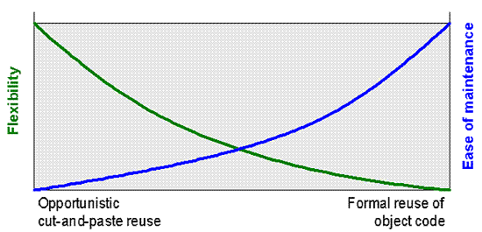
A spectrum of reuse

Slide 36
Types of reuse
Concerning motivation and driving factors, reuse can be:
Opportunistic - While getting ready to begin a project, the team realizes that there are existing components that they can reuse.
Planned - A team strategically designs components so that they'll be reusable in future projects.
Reuse can be categorized further:
Internal reuse - A team reuses its own components. This may be a business decision, since the team may want to control a component critical to the project.
External reuse - A team may choose to license a third-party component. Licensing a third-party component typically costs the team 1 to 20 percent of what it would cost to develop internally. The team must also consider the time it takes to find, learn and integrate the component.

Slide 37
Reuse levels
The abstraction level
At this level, you don’t reuse software directly but use knowledge of successful abstractions in the design of your software.
The object level
At this level, you directly reuse objects from a library rather than writing the code yourself.
The component level
Components are collections of objects and object classes that you reuse in application systems.
The system level
At this level, you reuse entire application systems.

Slide 38
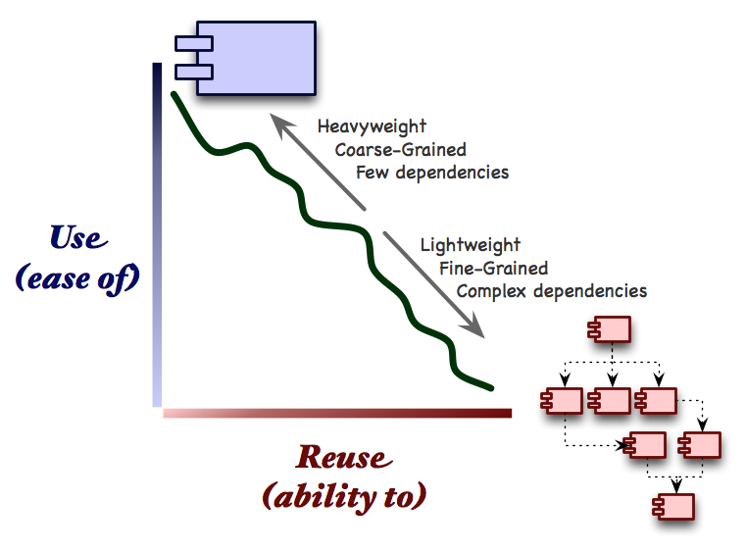
Use versus reuse

Slide 39
Reuse costs
The costs of the time spent in looking for software to reuse and assessing whether or not it meets your needs.
Where applicable, the costs of buying the reusable software. For large off-the-shelf systems, these costs can be very high.
The costs of adapting and configuring the reusable software components or systems to reflect the requirements of the system that you are developing.
The costs of integrating reusable software elements with each other (if you are using software from different sources) and with the new code that you have developed.

Slide 40
Reuse: costs versus benefits
Do the Reuse only when:
Costs < Benefits

Slide 41
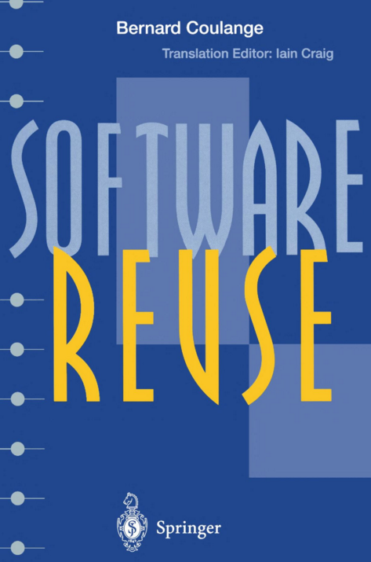
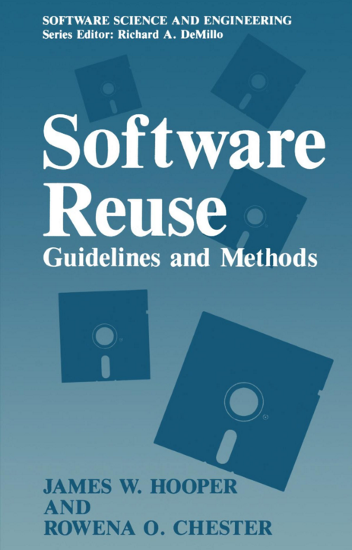
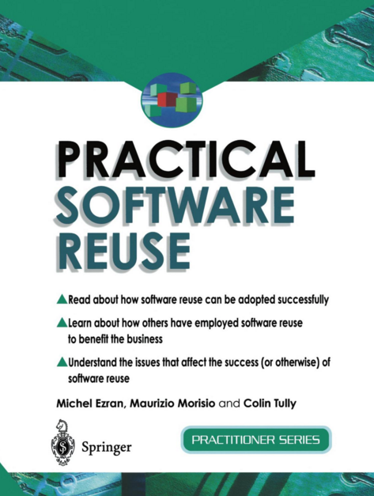
Book on Reuse: Many…

Slide 42
Implementation issues
Focus here is not on programming, although this is obviously important, but on other implementation issues that are often not covered in programming books (or courses):
Reuse: Most modern software is constructed by reusing existing components or systems. When you are developing software, you should make as much use as possible of existing code.
Configuration management: During the development process, you have to keep track of the many different versions of each software component in a configuration management system.
Host-target development: Production software does not usually execute on the same computer as the software development environment. Rather, you develop it on one computer (the host system) and execute it on a separate computer (the target system).

Slide 43
Configuration management
Configuration management is the name given to the general process of managing a changing software system.
The aim of configuration management is to support the system integration process so that all developers can access the project code and documents in a controlled way, find out what changes have been made, and compile and link components to create a system.
See also Chapter 25 of the book

Slide 44
Configuration management activities
Version management, where support is provided to keep track of the different versions of software components. Version management systems include facilities to coordinate development by several programmers.
System integration, where support is provided to help developers define what versions of components are used to create each version of a system. This description is then used to build a system automatically by compiling and linking the required components.
Problem tracking, where support is provided to allow users to report bugs and other problems, and to allow all developers to see who is working on these problems and when they are fixed.

Slide 45
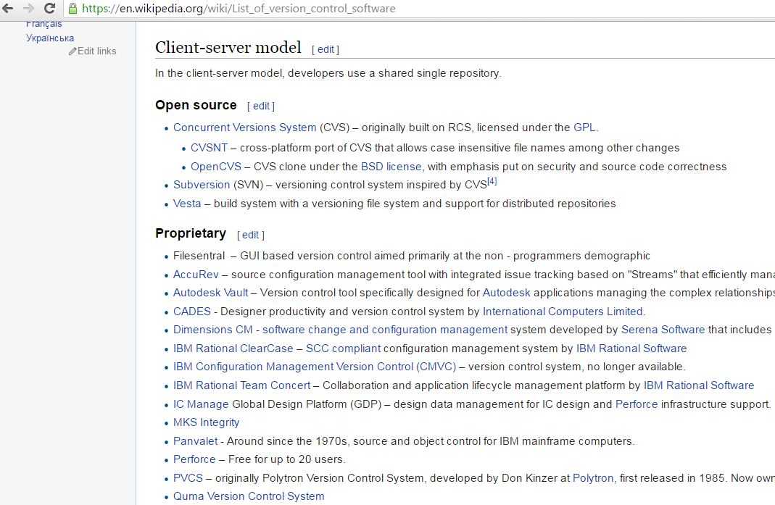
Configuration management: Version management

Slide 46
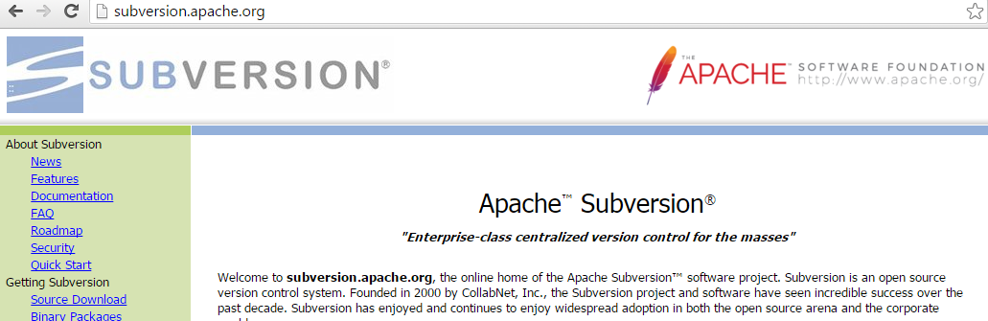
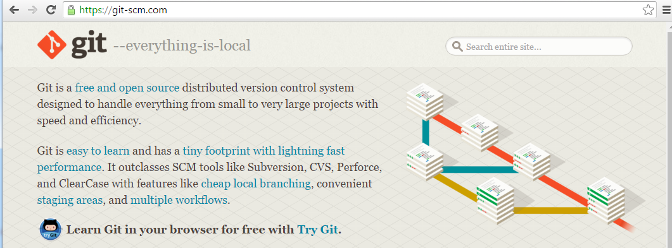
Configuration management: Version management

Slide 47
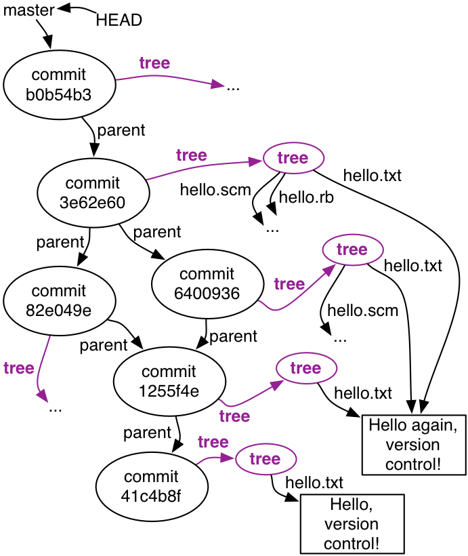
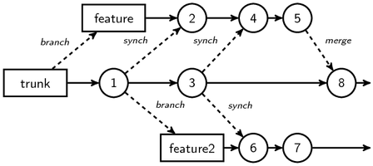
Configuration management: Version management
Version control graphs…

Slide 48
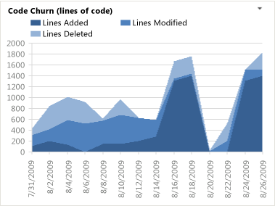
Configuration management: Version management
Code churn: defined as lines added, modified or deleted to a file from one version to another. We dimension it by the following:
User
Date/Time
Changeset
Portfolio Project
Path

Slide 49
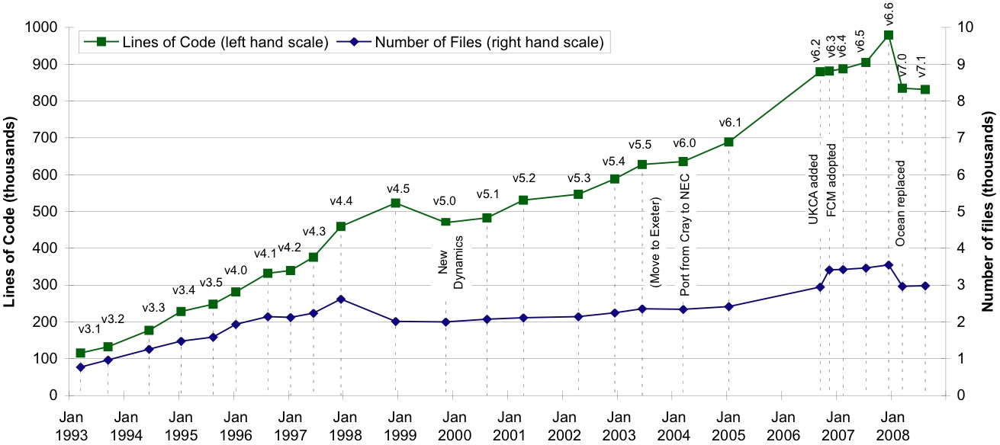
Configuration management: Version management
Studying code growth and churn
http://www.easterbrook.ca/steve/2009/07/growth-of-code-complexity/

Slide 50
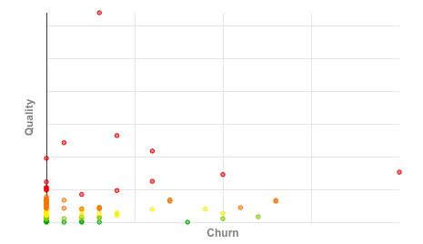
Configuration management: Version management
Code churn versus quality: more changes would USUALLY results in more bugs!
https://docs.codeclimate.com/docs/churn

Slide 51
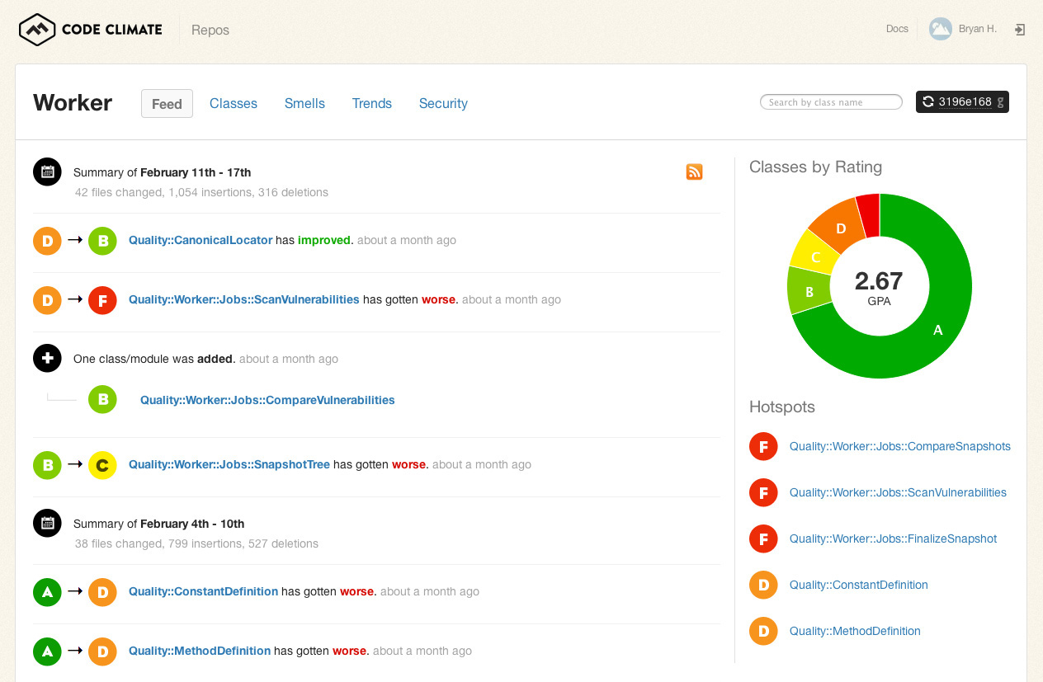
Configuration management: Version management
Many tools to manage large code bases and monitor quality…

Slide 52
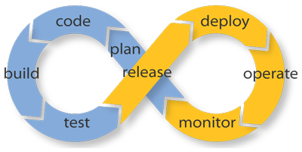
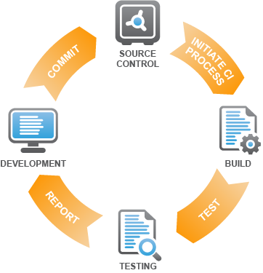
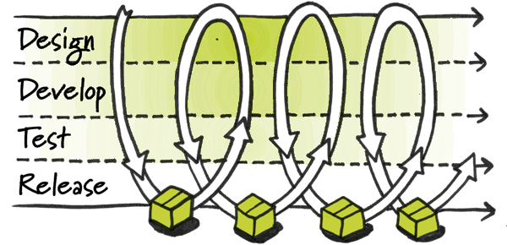
Configuration management: System integration
Continuous Integration (CI) is a development practice that requires developers to integrate code into a shared repository several times a day.
Each check-in is then verified by an automated build, allowing teams to detect problems early.

Slide 53
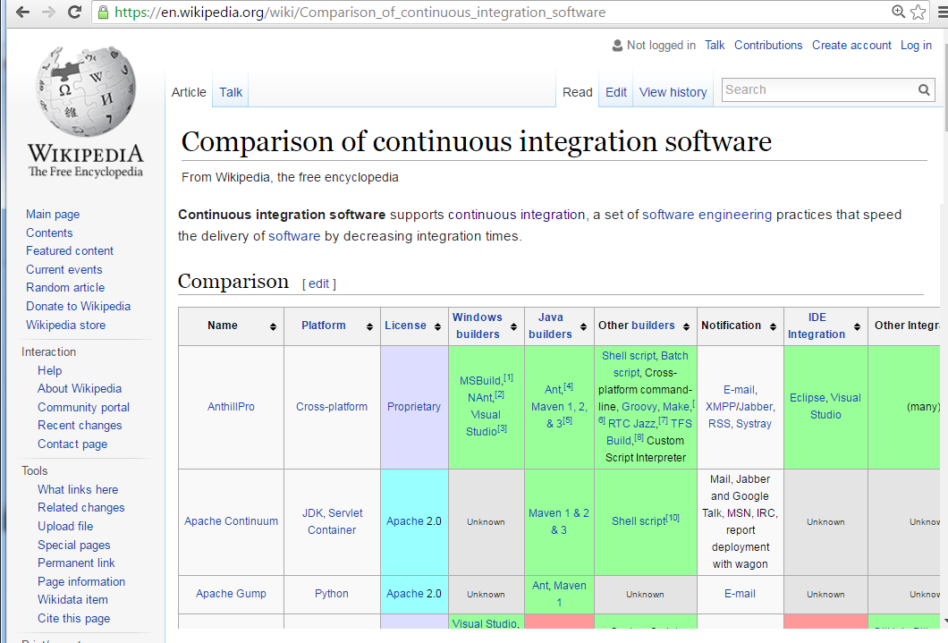
Configuration management: System integration

Slide 54
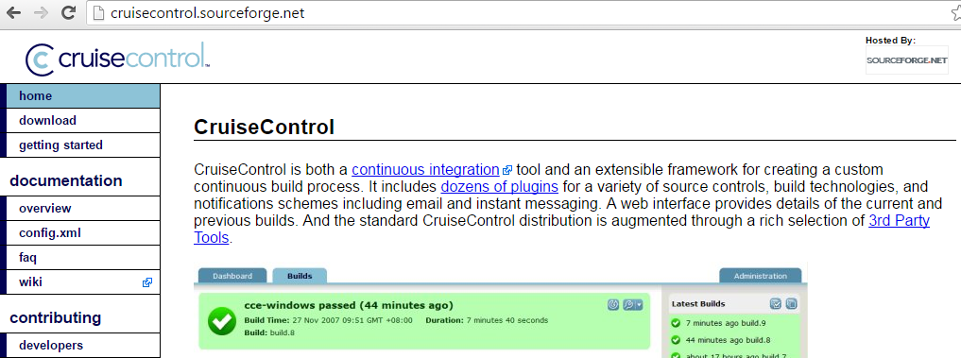

Configuration management: System integration

Slide 55

Configuration management: System integration

Slide 56
Configuration management: Issue tracking
Support is provided to allow users to report bugs and other problems, and to allow all developers to see who is working on these problems and when they are fixed.
There are usually four types of issues:
Bugs
Feature requests
Support requests
Source-code patches

Slide 57

Configuration management: Issue tracking
For Android, as of Mar. 21, 2016, 47376 issues were reported!

Slide 58

Configuration management: Issue tracking
A SIMPLE issue handling process for projects

Slide 59

Configuration management: Issue tracking
A MORE COMPLEX issue handling process for projects

Slide 60

Configuration management: Issue tracking
Let us see some Assigned issues

Slide 61

Configuration management: Issue tracking
Let us see some Assigned issues
Not fixed as of Mar. 21, 2016!

Slide 62

Configuration management: Issue tracking
Issues keep coming!
Date: Mar. 21, 2016

Slide 63

Configuration management: Issue tracking
Popularity of issues

Slide 64

Configuration management: Issue tracking
Many tools

Slide 65


Configuration management: Issue tracking
Many tools

Slide 66


Configuration management: Issue tracking
Studies trends of issues in projects
IC: Issues closed
IO: Issues opened

Slide 67

Configuration management: Issue tracking
Studies the trends of issues in projects

Slide 68

Configuration management: Issue tracking
Statistics for handling different issue types

Slide 69
Implementation issues
Focus here is not on programming, although this is obviously important, but on other implementation issues that are often not covered in programming books (or courses):
Reuse: Most modern software is constructed by reusing existing components or systems. When you are developing software, you should make as much use as possible of existing code.
Configuration management: During the development process, you have to keep track of the many different versions of each software component in a configuration management system.
Host-target development: Production software does not usually execute on the same computer as the software development environment. Rather, you develop it on one computer (the host system) and execute it on a separate computer (the target system).

Slide 70

Host-target development
Most software is developed on one computer (the host), but runs on a separate machine (the target).
Mobile SW development

Slide 71

Host-target development
Most software is developed on one computer (the host), but runs on a separate machine (the target).
Embedded SW development

Slide 72

Host-target development
Most software is developed on one computer (the host), but runs on a separate machine (the target).
Embedded SW development in defense

Slide 73
Host-target development
More generally, we can talk about a development platform and an execution platform.
A platform is more than just hardware.
It includes the installed operating system plus other supporting software such as a database management system or, for development platforms, an interactive development environment.
Development platform usually has different installed software than execution platform; these platforms may have different architectures.

Slide 74
Development platform tools
An integrated compiler and syntax-directed editing system that allows you to create, edit and compile code.
A language debugging system.
Graphical editing tools, such as tools to edit UML models.
Testing tools, such as Junit that can automatically run a set of tests on a new version of a program.
Project support tools that help you organize the code for different development projects.

Slide 75
Integrated development environments (IDEs)
Software development tools are often grouped to create an integrated development environment (IDE).
An IDE is a set of software tools that supports different aspects of software development, within some common framework and user interface.
IDEs are created to support development in a specific programming language such as Java. The language IDE may be developed specially, or may be an instantiation of a general-purpose IDE, with specific language-support tools.

Slide 76
Chapter 7 – Design and Implementation
Design patterns
Implementation issues
Open-source development

Slide 77
Open-source development
Open-source development is an approach to software development in which the source code of a software system is published and volunteers are invited to participate in the development process
Its roots are in the Free Software Foundation (www.fsf.org), which advocates that source code should not be proprietary but rather should always be available for users to examine and modify as they wish.
Open-source software extended this idea by using the Internet to recruit a much larger population of volunteer developers. Many of them are also users of the code.

Slide 78

Open-source systems
There are many major open-source products, e.g., the Linux operating system which is widely used as a server system and, increasingly, as a desktop environment.
Other important Open-source products are Java, the Apache web server and the MySQL database management system.

Slide 79

A closer look at Linux
https://linuxator.wordpress.com/2008/07/22/5-things-you-didnt-know-about-linux-kernel-code-metrics/

Slide 80

A closer look at Linux

Slide 81

A closer look at Linux: More…

Slide 82
Open-source issues
When you develop a new software:
Should the product that is being developed make use of Open-source components?
Should an Open-source approach be used for the software’s development?

Slide 83

Lots of places to search for Open-source SW (code)

Slide 84

Lots of places to search for Open-source SW (code)

Slide 85

Lots of places to search for Open-source SW (code)

Slide 86
Open-source business
More and more product companies are using an Open-source approach to development.
Their business model is not reliant on selling a software product but on selling support for that product.
They believe that involving the Open-source community will allow software to be developed more cheaply, more quickly and will create a community of users for the software.

Slide 87
Open-source licensing
A fundamental principle of open-source development is that source code should be freely available, this does not mean that anyone can do as they wish with that code.
Legally, the developer of the code (either a company or an individual) still owns the code. They can place restrictions on how it is used by including legally binding conditions in an Open-source software license.
Some Open-source developers believe that if an Open-source component is used to develop a new system, then that system should also be Open-source.
Others are willing to allow their code to be used without this restriction. The developed systems may be proprietary and sold as closed source systems.

Slide 88
License models
The GNU General Public License (GPL). This is a so-called ‘reciprocal’ license that means that if you use Open-source software that is licensed under the GPL license, then you must make that software Open-source.
The GNU Lesser General Public License (LGPL) is a variant of the GPL license where you can write components that link to Open-source code without having to publish the source of these components.
The Berkley Standard Distribution (BSD) License. This is a non-reciprocal license, which means you are not obliged to re-publish any changes or modifications made to Open-source code. You can include the code in proprietary systems that are sold.

Slide 89

License models

Slide 90
License management
Establish a system for maintaining information about open-source components that are downloaded and used.
Be aware of the different types of licenses and understand how a component is licensed before it is used.
Be aware of evolution pathways for components.
Educate people about Open-source.
Have auditing systems in place.
Participate in the Open-source community.

Slide 91
END OF Chapter 7 – Design and Implementation
Object-oriented design using the UML
Design patterns
Implementation issues
Open-source development

Slide 92
For students

Slide 93

Design patterns: many of them

